Slide 1
DevOps
Workshop

Slide 2
Module 5
Objectives
Describe the company
Describe the services
Describe the architecture
Show how Amazon works
Show how Heroku works
Show how Bluemix works
Case Scenario
Notes:
Presentations: http://www.slideshare.net/quaip/docker-sysmana-2014
Book: The Docker Book: http://www.dockerbook.com

Slide 3
The company

Slide 4
The company: ExampleCorp
Introduction
ExampleCorp is an e-commerce business dedicated to telecom devices.
Has presence in Europe.
About 100 employees. 30 are IT people.
External domain: examplecorp.es
Internal domain: examplecorp.lab

Slide 5
The services

Slide 6
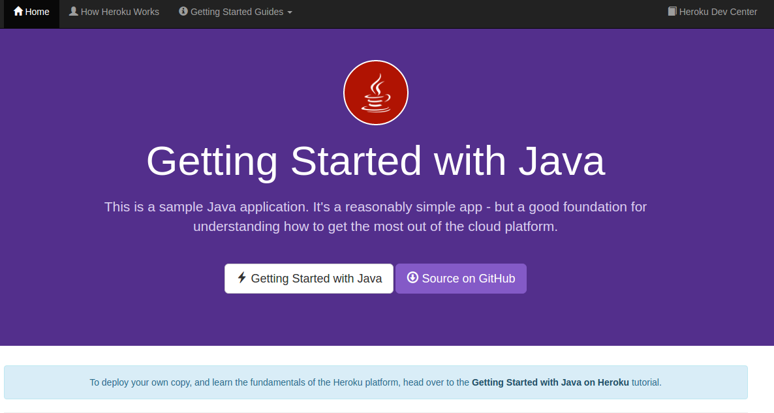

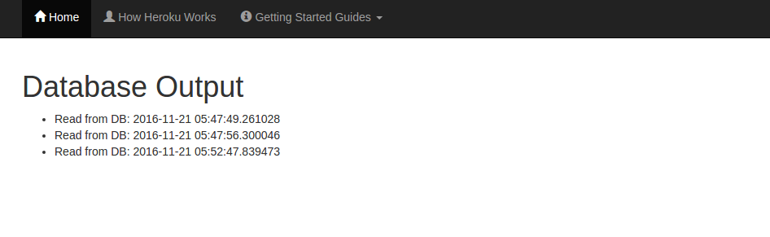
The services
Sample app 1
It is a sample java application, used to demonstrate how maven build tool works.
It has three parts: a presentation page, a hello world sample, and a db access sample.
We will use this app to show how to build a CI&CD toolchain.

Slide 7
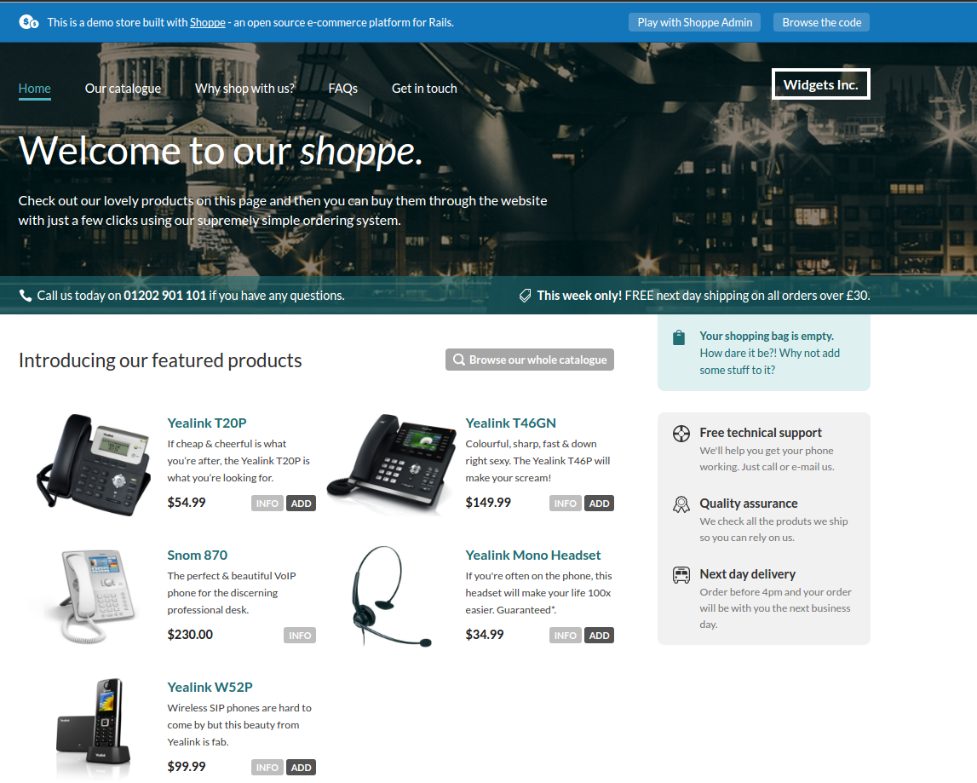
The services
The shop
The shop is the main application managed by the IT department.
Is a ruby on rails application.
We will use it to test final parts of cloud services, like heroku and bluemix.

Slide 8
The architecture

Slide 9
Amazon Web Services

Slide 10
The Architecture
AWS
development
qa
staging
production
web
web
web
web
app
app
app
app
db
db
db
db

Slide 11
Heroku

Slide 12
The Architecture
Heroku Pipelines
staging
production
web
web
PR-4
app
app
PR-3
db
db
PR-2
PR-1
PR-3
PR-3
Notes:
https://devcenter.heroku.com/articles/pipelines

Slide 13
Heroku
Introduction
Please, watch this presentation:
http://www.slideshare.net/JR0cket/introduction-to-heroku-cct-london-2013

Slide 14
IBM Bluemix

Slide 15
Bluemix
Introduction
Please, watch this presentation:
http://www.slideshare.net/ormium/ibm-codename-bluemix-cloudfoundry-paas-development-and-deployment-training-ibm-innovation-center-zurich

Slide 16
Summary Module 5
Do we have a good understanding about?
The company
The services the company provides?
The architecture
Amazon AWS
Heroku
Bluemix
Case Scenario

